Slide 1



Consumer Goods Ad_hoc Analysis
Created by: Fayazuddin sikalgar
(Junior data analyst)

Slide 2

INTRODUCTION
Atliq Hardwares is one of the leading computer hardware producers in India and well expanded in other countries too.

Slide 3
Operating segments & regions
Peripherals
Accessories
Notebook
APAC
EU
Segments
NA
LATAM
Desktop
Storage
Networking

Slide 4




Distribution networks
Networks
Bricks & Mortar
E- Commerce
Distributors
Retailers
Direct
Market platforms
Direct

Slide 5

Problem statement
The management noticed that they do not get enough insights to make quick and smart data-informed decisions.
Answers the ‘ad-hoc-requests’ - there are 10 ad hoc requests for which the business needs insights.

Slide 6
Ad-hoc-request 1
Provide the list of markets in which customer "Atliq Exclusive" operates its business in the APAC region.

Slide 7
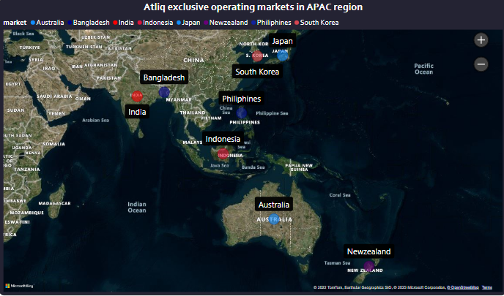
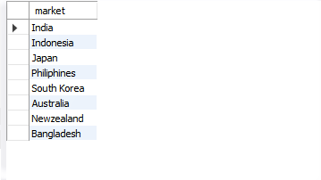
Solution & insights
Atliq exclusive operates in 8 markets in APAC region with 9 operational stores.

Slide 8
Ad-hoc-request 2
What is the percentage of unique product increase in 2021 vs. 2020?
The final output contains these fields;
unique_products_2020, unique_products_2021, percentage_chg

Slide 9
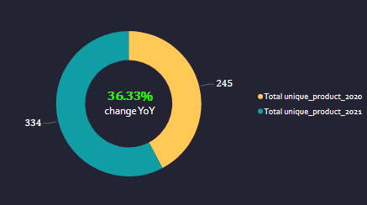

Solution & insights
There was total 36.33% increase in total count of unique product over FY 2020-21
The increase is due to high product usage in the FY 2019-2020 due to covid-19 restrictions worldwide

Slide 10
Ad-hoc-request 3
Provide a report with all the unique product counts for each segment and sort them in descending order of product counts.
The final output contains 2 fields; segment, product_count

Slide 11
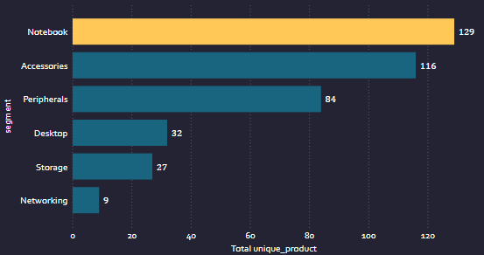
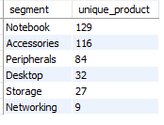
Solution & insights
Notebook has the highest share of 32.49%, accessories has 29.21% and peripherals has 21.15% in total product count of atliq hardware across different segments

Slide 12
Ad-hoc-request 4
Which segment had the most increase in unique products in 2021 vs 2020?
The final output contains these fields;
Segment, product_count_2020, product_count_2021, difference

Slide 13
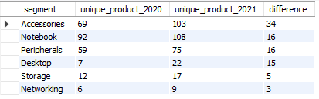
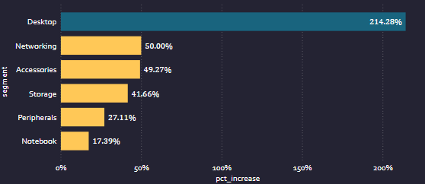
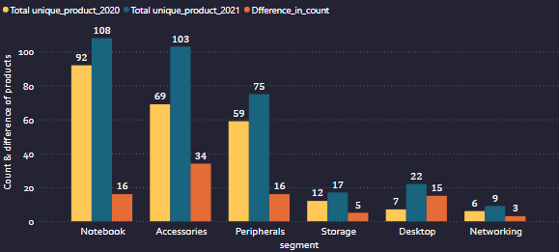
Solution & insights

Slide 14
Ad-hoc-request 5
Get the products that have the highest and lowest manufacturing costs.
The final output should contain these fields;
product_code, product manufacturing_cost

Slide 15
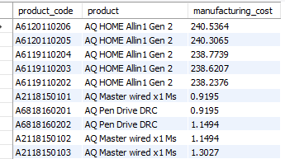
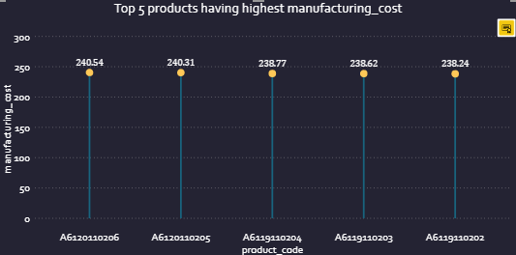
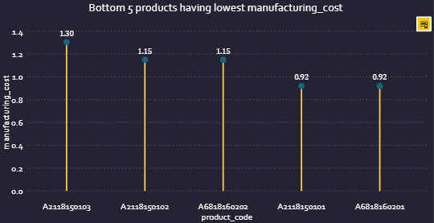
Solution & insights
AQ HOME Allin 1 Gen 2 has highest manufacturing cost in FY2021
Segment- Desktop
Product category - Personal desktop
Cost increase due to increase in price of component's because of chip shortage and high demand of products due to pandemic

Slide 16
Ad-hoc-request 6
Generate a report which contains the top 5 customers who received an average high pre_invoice_discount_pct for the fiscal year 2021 and in the Indian market.
The final output contains these fields;
customer_code customer average_discount_percentage

Slide 17
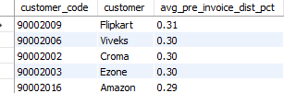
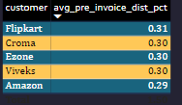
Solution & insights
These customers are frequent bulk buyer of our products
Sales of all these customers has gone up in FY2021
Amazon purchases most frequently in moderate quantity each month in FY2020 and FY2021
Our product was more get noticed on these customers platform

Slide 18
Ad-hoc-request 7
Get the complete report of the Gross sales amount for the customer “Atliq Exclusive” for each month . This analysis helps to get an idea of low and high-performing months and take strategic decisions.
The final report contains these columns: Month, Year, Gross sales Amount

Slide 19
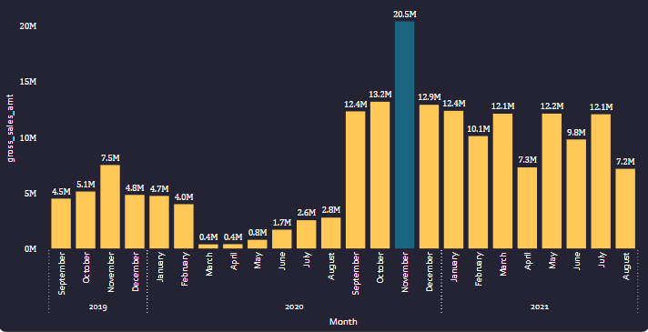
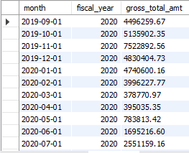
Solution & insights
Gross sales in FY2019-20 was 39.31M and in FY2020-21 it was 142.21M
Due pandemic sales increased by 261.76%
The sales declined in Q3 of FY2019-20 due to sudden outbreak covid-19 which lockdown almost entire world and this resulted in disruptions to both the supply and demand of PCs and its components.
IDC (International data corporation) defines the PC market as desktops, notebooks (including Chromebooks) and workstations in FY2019-20. We added new desktop in FY2020-21 to meet the growing demand

Slide 20
Ad-hoc-request 8
In which quarter of 2020, got the maximum total_sold_quantity?
The final output contains these fields sorted by the total_sold_quantity;
Quarter, total_sold_quantity

Slide 21
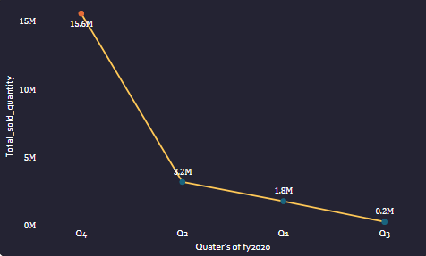

Solution & insights
Due pandemic, we sold highest quantity of 15.6M in Q4 of FY2019-20
We sold total 0.2M quantity in Q3, 3.2M quantity in Q2 and 1.8M quantity in Q1 of FY2019-20.
In Q3 covid-19 was at peak due to which our sales declined

Slide 22
Ad-hoc-request 9
Which channel helped to bring more gross sales in the fiscal year 2021 and the percentage of contribution?
The final output contains these fields; channel, gross_sales_mln, percentage

Slide 23
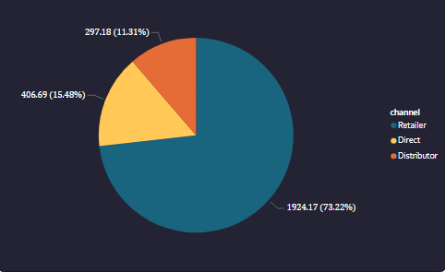

Solution & insights
Our major part of business were coming from retailers channel (73.21% contribution) in FY2020-21 due to large customer base on this channel
Direct channel comprises of platforms where Atliq directly selling to end users and it contributed to around 15.47% to total gross sales in FY2020-21
Distributors contributed the least to total gross sales of around 11.30% in FY2020-21.There are only 5 distributors of Atliq in 3 different markets

Slide 24
Ad-hoc-request 10
Get the Top 3 products in each division that have a high total_sold_quantity in the fiscal_year 2021?
The final output contains these fields; division, product_code, product, total_sold_quantity, rank_order

Slide 25
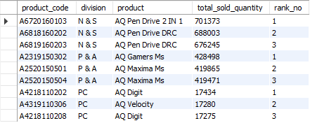
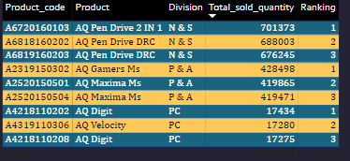
Solution & insights
In Q4 of FY2020-21 we sold the highest quantity of 36M
The products ranking were differentiated by its variants
AQ Pen Drive DRC has 2 variants i.e. Plus and Premium
AQ Maxima Ms variants in ranking were Standard 1 and Plus 2
AQ Digit has variants in Standard blue and Premium Misty Green

Slide 26
Additional Ad-hoc-request
Conduct a channels wise gross sales comparison for fiscal year 2020 and 2021?

Slide 27
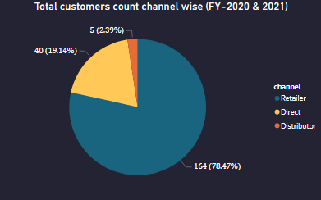
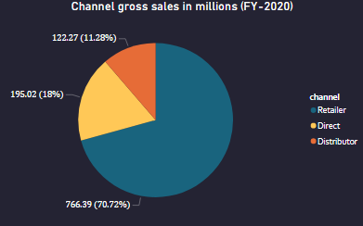
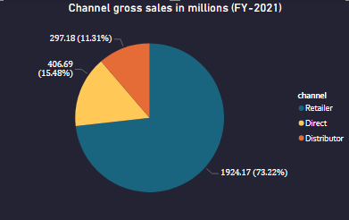
Solution & insights
We had same number of customers in both FY2020 and FY2021
The contribution from retail channel has gone up by 2.5% in FY-2021
Direct channel share has got declined by 2.52% in FY-2021

